Slide 1

Final Project Neural Network Default Model
Ding, Zirui
CSCI E-63 Big Data Analytics
Harvard University Extension School
Prof. Zoran B. Djordjević

Slide 2
Introduction
Traditional default models were built on logistic regression. The form of the model is fixed and the number of variables are limited. It may be hard for the model to capture certain relationship due to its pre-defined structure.
Because of my background, I have exposure to various default models developed and used in the bank. Usually, these traditional statistic models can capture the trend, but seldom can I see a model with outstanding prediction accuracy that some neural network can achieve.
In this project, I try to use neural net to build default prediction model with TensorFlow.

Slide 3
Data Pre-processing
The original data were sourced from Kaggle, provided by Lendging Club. (https://www.kaggle.com/wendykan/lending-club-loan-data)
The dataset itself contains loan payment information concerning individual loans issues by lending club from 2007 to 2015. Dataset include information from basic loan characters to borrower’s credit records and occupation.
Concerning the limited time and computation power, I started the project with 8 input variables, namely home ownership, number of queries in last 6-month,purpose, term of the loan, interest rate, annual income and earliest credit line.
However, not all variables are numeric. I convert the non-numeric values into categorical data.

Slide 4
Data Pre-processing –Cont.
For default, I refer to the column of “loan_status”. All value shown as “Fully Paid”, “current”, “Issued” or “Does not meet the credit policy. Status:Fully Paid” are marked as non default loans. The rest are loans defaulted.
Loan purpose and homeownership can be easily converted into categorcal data and replace with numbers.
For earliest_cre_line, I use the earliest time in the data as the baseline date and calculate the numbers of days for each instance to convert the date format into continuous numbers we can apply in the model efficiently.
The detailed code can be found in “Data Preprocessing” notebook.

Slide 5
1 Hidden Layer Model
Basic Structure
import tensorflow as tf
#set placeholder for
input_x=tf.placeholder(dtype=tf.float32,shape=(None,8))
input_y=tf.placeholder(dtype=tf.int32,shape=(None))
#set variables to calculate the number of
n_neural=10
#initialize the transfer matrix and bias term
w1 = tf.Variable(tf.truncated_normal([8, n_neural], stddev=0.1), name="W")
b1=tf.Variable(tf.zeros([n_neural]), name="B",dtype=tf.float32)
w2 = tf.Variable(tf.truncated_normal([n_neural,2], stddev=0.1), name="W")
b2=tf.Variable(tf.zeros([2]), name="B",dtype=tf.float32)
#construct the hidden layer layer
net=tf.nn.relu(tf.add(tf.matmul(input_x,w1),b1))
#output layer
logits=tf.add(tf.matmul(net,w2),b2)
#construct the loss function
loss=tf.reduce_mean(tf.nn.sparse_softmax_cross_entropy_with_logits(logits=logits,labels=input_y))
#optimization fucntion
learning_rate = 0.001
optimizer = tf.train.AdamOptimizer(learning_rate)
training_op = optimizer.minimize(loss)
probability=tf.nn.softmax(logits)
classification=tf.nn.in_top_k(logits, input_y, 1)
accuracy=tf.reduce_mean(tf.cast(classification,tf.float32))

Slide 6

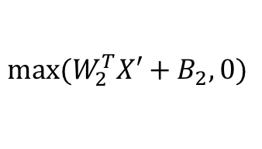









1 Hidden Layer Model – Cont.
The below diagram elaborates how this one-hidden layer neural network works.
Raw data goes through linear transformation and relu function in the hidden layer
Output from the hidden layer is linearly transformed to output layer. Softmax function calculates probability for each class (2 here, default/not default)
Softmax
Output Layer
$$Σ$$
$$Σ$$
$${max⁡(W}_{2}^{T}X′+B_{2},0)$$
_$/$
_$/$
…
_$/$
Hidden Layer
(10 nodes)
$$Σ$$
$$Σ$$
$$Σ$$
$$W_{1}^{T}X+B_{1},0$$
$$X_{1}$$
$$X_{2}$$
…
$$X_{8}$$
Input Layer
(Loan Characters)

Slide 7
1 Hidden Layer Model – Cont.
AdamOptimizer is used instead of the GradientDescentOptimizer. It is because after rounds of adjustment of the parameters (number of nodes and number of hidden layers), it seems that the results produced by GtadientDescentOptimizer across different nodes and layers are the same. After checking literature, I switched to AdamOptimizer.
Learning rate is set to 0.001, which is the default learning rate for AdamOptimizer.
Softmax function is not directly applied at the output layer. So we can use the function sparse_softmax_cross_entropy_with_logits(). The function is equivalent to applying the softmax function and then computing the cross entropy. But it is more efficient to handle corner cases.
Accuracy is calculated by taking the largest probability value as the final category assignment (default or not default).
The training data set is split into batches of 50 and send to train the model.
10 prediction results are presented together with actual label to give an idea how the model output looks like.
The train set and validation set accuracy are roughly the same as 0.923.

Slide 8
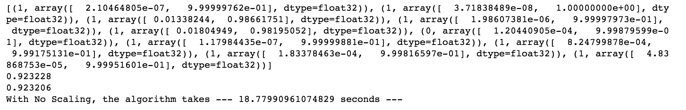
1 Hidden Layer Model – Cont.
Without scaling the variables, the 10-node 1 hidden layer model provides test set accuracy of 0.923228 and validation set accuracy of 0.923206
init = tf.global_variables_initializer()
batch_size=50
with tf.Session() as sess:
init.run()
for iteration in range(len(train_set.index.values)//batch_size):
X=train_set.iloc[(iteration*batch_size):((iteration+1)*batch_size),0:8]
y=train_set.iloc[(iteration*batch_size):((iteration+1)*batch_size),8]
lo=sess.run([training_op],feed_dict={input_x:X,input_y:y})
#running test set and validation set
test_prediction,test_accuracy=sess.run([probability,accuracy],feed_dict={input_x:test_set.iloc[:,0:8],input_y:test_set.iloc[:,8]})
print(list(zip(test_set.iloc[:,8],test_prediction))[0:10])
print(test_accuracy)
validate_prediction,validate_accuracy=sess.run([probability,accuracy],feed_dict={input_x:validation_set.iloc[:,0:8],input_y:validation_set.iloc[:,8]})
#print(zip(validation_set.iloc[:,8],validate_prediction))
print(validate_accuracy)
sess.close()

Slide 9
1 Hidden Layer Model – Cont.
In this part, I purposely try not to scale the dataset in order to make comparison if scaling the data can help enhance the execution time or accuracy.
The scaling functions are designed as below:
#design the function to resclae the data to adjust the loan amount, interest rate, annual income and earliest credit line
from sklearn import preprocessing
def scale_train_data(df):
target=['loan_amnt','int_rate','annual_inc','earliest_cre_line']
new_df=df.loc[:,df.columns.difference(target)]
loan_amount_scaler=preprocessing.StandardScaler().fit(df[target[0]].reshape(-1, 1))
new_df['scaled_'+target[0]]=loan_amount_scaler.transform(df[target[0]].reshape(-1, 1))
int_rate_scaler=preprocessing.StandardScaler().fit(df[target[1]].reshape(-1, 1))
new_df['scaled_'+target[1]]=int_rate_scaler.transform(df[target[1]].reshape(-1, 1))
annual_inc_scaler=preprocessing.StandardScaler().fit(df[target[2]].reshape(-1, 1))
new_df['scaled_'+target[2]]=annual_inc_scaler.transform(df[target[2]].reshape(-1, 1))
earliest_cre_line_scaler=preprocessing.StandardScaler().fit(df[target[3]].reshape(-1, 1))
new_df['scaled_'+target[3]]=earliest_cre_line_scaler.transform(df[target[3]].reshape(-1, 1))
return new_df,[loan_amount_scaler,int_rate_scaler,annual_inc_scaler,earliest_cre_line_scaler]
#design the function to apply the scaler onto test and validation set
def apply_scaler(df,scaler_list):
target=['loan_amnt','int_rate','annual_inc','earliest_cre_line']
new_df=df.loc[:,df.columns.difference(target)]
for i in range(len(target)): new_df['scaled_'+target[i]]=scaler_list[i].transform(df[target[i]].reshape(-1, 1))
return new_df
scaled_train_set,scaler_list=scale_train_data(train_set)
scaled_test_set=apply_scaler(test_set,scaler_list)
scaled_validation_set=apply_scaler(validation_set,scaler_list)

Slide 10
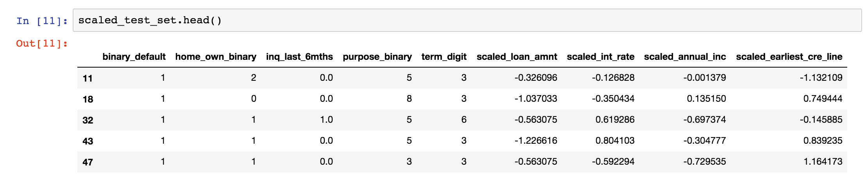
1 Hidden Layer Model – Cont.
The first function scale_train_data() uses training data set as input.
StandardScaler function under sklearn is used to transform the four target input variables, namely loan amount, interest rate, annual income and earliest credit line.
The function transforms the target variable into zero mean, unit variance variable.
It returns the transformed training dataset together with the four scaling functions.
in the second function apply_scaler(), testing set and validation set are transformed using the scaling functions.
An example of scaled dataset is shown below:

Slide 11
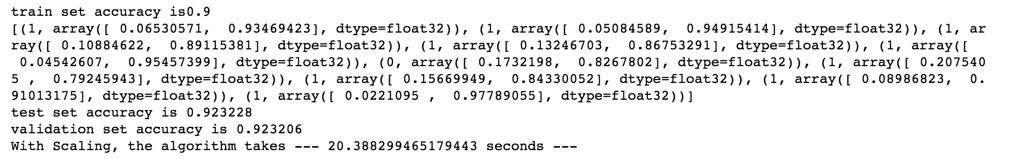
1 Hidden Layer Model – Cont.
After scaling the variables, the 10-node 1 hidden layer model provides the same accuracy. The running time is 2 seconds behind. The impact of scaling is minor in this case.
batch_size=50
init = tf.global_variables_initializer()
with tf.Session() as sess:
init.run()
for iteration in range(len(scaled_train_set.index.values)//batch_size):
X=scaled_train_set.iloc[(iteration*batch_size):((iteration+1)*batch_size),1:9]
y=scaled_train_set.iloc[(iteration*batch_size):((iteration+1)*batch_size),0]
lo=sess.run([training_op],feed_dict={input_x:X,input_y:y})
#running test set and validation set
test_prediction,test_accuracy=sess.run([probability,accuracy],feed_dict={input_x:scaled_test_set.iloc[:,1:9],input_y:scaled_test_set.iloc[:,0]})
print(list(zip(scaled_test_set.iloc[:,0],test_prediction))[0:10])
print(test_accuracy)
validate_prediction,validate_accuracy=sess.run([probability,accuracy],feed_dict={input_x:scaled_validation_set.iloc[:,1:9],input_y:scaled_validation_set.iloc[:,0]})
#print(zip(validation_set.iloc[:,8],validate_prediction))
print(validate_accuracy)
sess.close()

Slide 12
1 Hidden Layer Model – Cont.
I packed the function so we can adjust the number of nodes in the 1-hidden layer structure to explore how changing nodes can will impact the accuracy and efficiency of the model.
for n in [4,6,8,10,12,14,16]:
hidden=construct_neural_layer(n,input_x,"Hidden_Layer",activation_fnc="relu")
output=construct_neural_layer(2,hidden,"Output_Layer")
loss=tf.reduce_mean(tf.nn.sparse_softmax_cross_entropy_with_logits(labels=input_y,logits=output))
accuracy=tf.reduce_mean(tf.cast(tf.nn.in_top_k(output,input_y,1),tf.float32))
with tf.name_scope("train"):
optimizer = tf.train.AdamOptimizer(learning_rate)
training_op = optimizer.minimize(loss)
init = tf.global_variables_initializer()
start_time=time.time()
with tf.Session() as sess:
init.run()
for iters in range(len(scaled_train_set.index.values)//batch_size):
x=scaled_train_set.iloc[(iters*batch_size):((iters+1)*batch_size),1:9]
y=scaled_train_set.iloc[(iters*batch_size):((iters+1)*batch_size),0]
train_loss,train_accuracy=sess.run([training_op,accuracy],feed_dict={input_x:x,input_y:y})
#add summary if needed later
acc_train=accuracy.eval(feed_dict={input_x:x,input_y:y})
acc_test=accuracy.eval(feed_dict={input_x:scaled_test_set.iloc[:,1:9],input_y:scaled_test_set.iloc[:,0]})
acc_valid=accuracy.eval(feed_dict={input_x:scaled_validation_set.iloc[:,1:9],input_y:scaled_validation_set.iloc[:,0]})
sess.close()

Slide 13
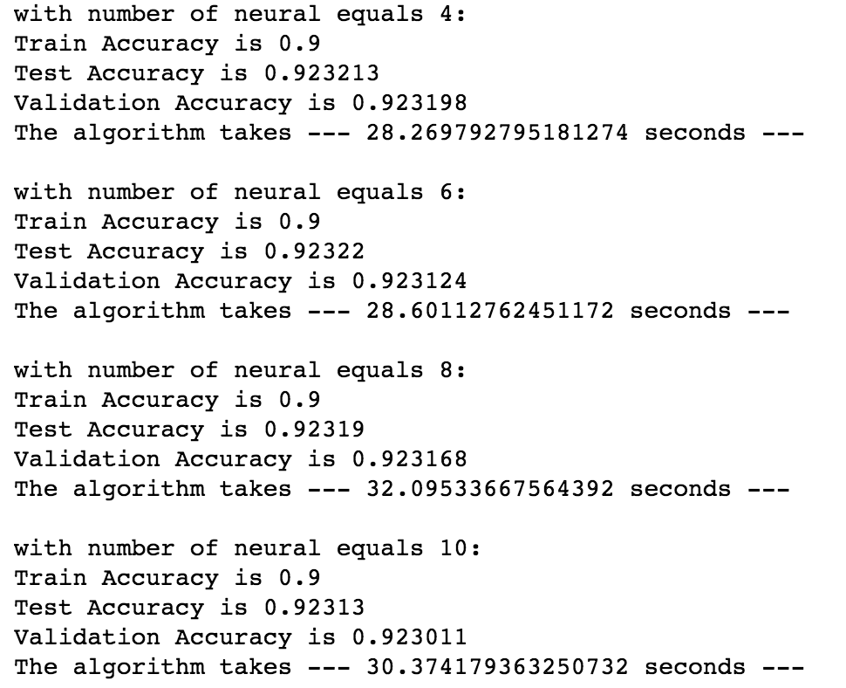
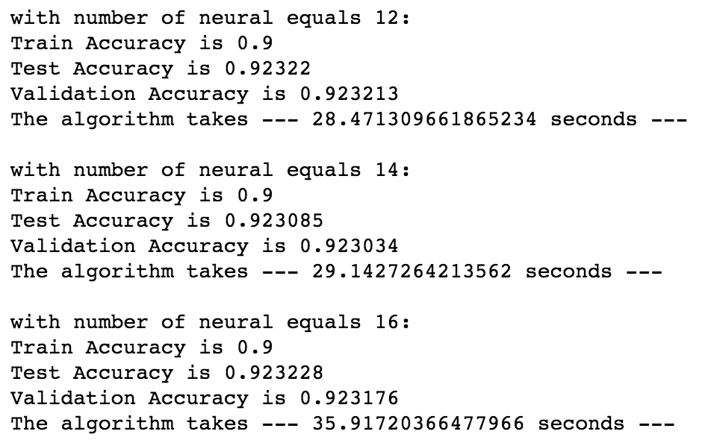
1 Hidden Layer Model – Cont.
In fact, adjusting the number of neurons in the hidden layer does not impact the model performance a lot.
I assume that more neurons may take the program longer time to calibrate the model. However, it seems not that simple. 16 neurons did take longest time to train, but the second most time consuming model is the one with 8 neurons instead of 14.

Slide 14

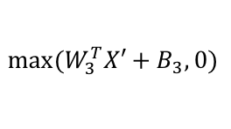





2 Hidden Layers Model
In order to explore other means to improve the model prediction power, I extended the model to multi-layers to see if deeper neural network can help boost model performance.
The model structure is shown below:
Softmax
$$Σ$$
$$Σ$$
Output Layer
$${max⁡(W}_{3}^{T}X′+B_{3},0)$$
_$/$
_$/$
…
_$/$
Hidden Layer 2
(5 nodes)
$$Σ$$
$$Σ$$
$$Σ$$
$${max⁡(W}_{2}^{T}X′+B_{2},0)$$
_$/$
…
_$/$
_$/$
Hidden Layer 1
(10 nodes)
$$Σ$$
$$Σ$$
$$Σ$$
$$W_{1}^{T}X+B_{1},0$$
$$X_{1}$$
$$X_{2}$$
…
$$X_{8}$$
Input Layer
(Loan Characters)

Slide 15
2 Hidden Layers Model – cont.
The basic structure is still the same with one hidden layer model except that the second hidden layer of 5 neurons are added.
The creation process is packed into a function to ease the coding process.
The function requires input variables, the output neuron numbers, name of the layer as well as the activation function.
I checked the reference, it seems that setting standard derivation to be 2/sqrt(num_of_variable) can make the algorithm more efficient*.
The activation_fnc input is designed to bring flexibility to pick the activation function.
import tensorflow as tf
import numpy as np
def construct_neural_layer(input_x, layer_nn,name, activation_fnc=None):
with tf.name_scope(name):
n_var=int(input_x.get_shape()[1])
#create random weights
stddev=2/np.sqrt(n_var)
w=tf.Variable(tf.truncated_normal((n_var,layer_nn),stddev=stddev),name="weight",dtype=tf.float32)
b=tf.Variable(tf.zeros([layer_nn]),name="biases",dtype=tf.float32)
output=tf.add(tf.matmul(input_x,w),b)
if activation_fnc=="sigmoid":
return tf.sigmoid(output)
elif activation_fnc=="relu":
return tf.nn.relu(output)
elif activation_fnc=="softmax":
return tf.nn.softmax(output)
else:
return output
*Aurélien Géron,Hands-on Machine Learning with Scikit-Learn and TensorFlow, ed.1, chapter 11

Slide 16
2 Hidden Layers Model – cont.
#set the variables number for two layers
layer1_nn=10
layer2_nn=5
input_x=tf.placeholder(tf.float32,shape=(None,8),name="X")
input_y=tf.placeholder(tf.int32,shape=(None),name="y")
batch_size=50
learning_rate=0.01
hidden1=construct_neural_layer(input_x,layer1_nn,"Hidden_Layer1",activation_fnc="relu")
hidden2=construct_neural_layer(hidden1,layer2_nn,"Hidden_Layer2",activation_fnc="relu")
output=construct_neural_layer(hidden2,2,"Output_Layer")
loss=tf.reduce_mean(tf.nn.sparse_softmax_cross_entropy_with_logits(labels=input_y,logits=output))
accuracy=tf.reduce_mean(tf.cast(tf.nn.in_top_k(output,input_y,1),tf.float32))
tf.summary.scalar('loss', loss)
tf.summary.scalar('accuracy', accuracy)
merged = tf.summary.merge_all()
train_writer = tf.summary.FileWriter('NN2_no_dropout')
with tf.name_scope("train"):
optimizer = tf.train.AdamOptimizer(learning_rate)
training_op = optimizer.minimize(loss)
init = tf.global_variables_initializer()
with tf.Session() as sess:
init.run()
for iters in range(len(scaled_train_set.index.values)//batch_size):
X=scaled_train_set.iloc[(iters*batch_size):((iters+1)*batch_size),1:9]
Y=scaled_train_set.iloc[(iters*batch_size):((iters+1)*batch_size),0]
opt,train_loss,train_accuracy,summ=sess.run([training_op,loss,accuracy,merged],feed_dict={input_x:X,input_y:Y})
train_writer.add_summary(summ,iters*batch_size)
test_loss,test_accuracy=sess.run([loss,accuracy],feed_dict={input_x:scaled_test_set.iloc[:,1:9],input_y:scaled_test_set.iloc[:,0]})
sess.close()

Slide 17
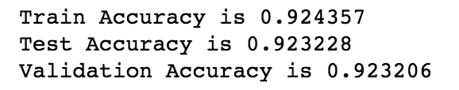
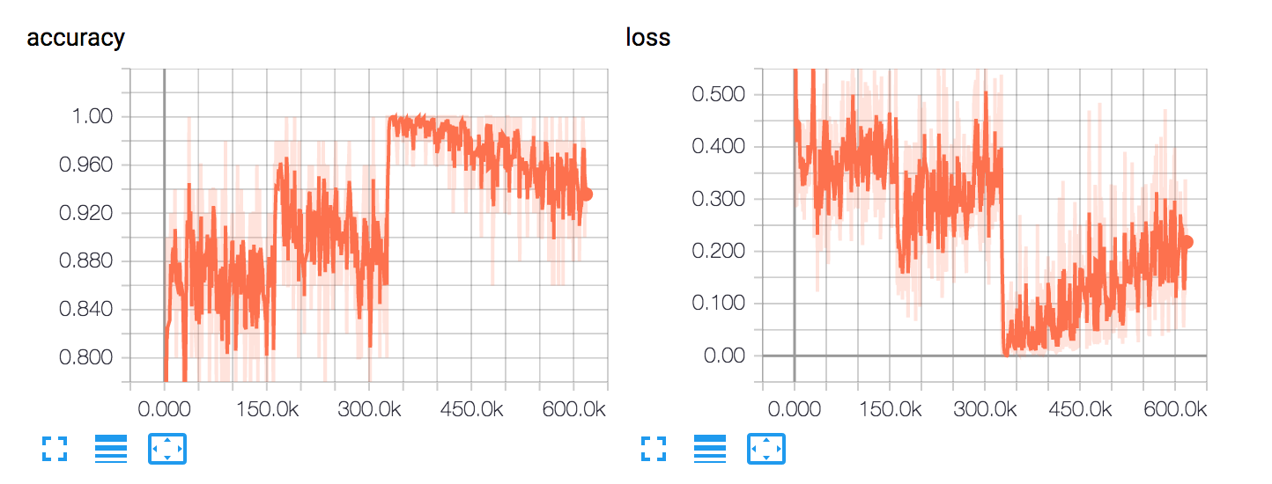
2 Hidden Layers Model – Cont.
The model prediction performance is shown as below. The additional layer did not bring a lot of improvements in terms of accuracy.
I added the accuracy and loss information in tensorbaord. Interestingly, the accuracy of the model actually decreases after the first half of training data.
The plot between training and testing accuracy/loss are also shown here to check if there are any overfitting. There is no obvious trend of overfitting except that the loss of testing set trended up slightly.

Slide 18
2 Hidden Layers Model – Cont.
Observing the slightly trending up of the loss function, I suspect there are overfitting in the model. I further checked if there are any techniques I can apply to reduce overfitting and improve prediction power on testing and validation set.
Once technique introduced in Google’s tutorial “Learn TensorFlow and deep learning, without a Ph.D.” is the dropout function.
The dropout function randomly select points to dropout at each layer to avoid overfitting. Again, I searched that the dropout rate of 0.5 brings most variation to the model. Thus, 0.5 is used in my experiment.
The code is pretty similar to the previous version except that dropout option is added with keep_prob default to 0.5.
def construct_neural_layer_with_dropout(input_x, layer_nn,name,drop_out=True,keep_prob=0.5,activation_fnc=None):
with tf.name_scope(name):
n_var=int(input_x.get_shape()[1])
#create random weights
stddev=2/np.sqrt(n_var)
w=tf.Variable(tf.truncated_normal((n_var,layer_nn),stddev=stddev),name="weight",dtype=tf.float32)
b=tf.Variable(tf.zeros([layer_nn]),name="biases",dtype=tf.float32)
output=tf.add(tf.matmul(input_x,w),b)
if activation_fnc=="sigmoid":
ans= tf.sigmoid(output)
elif activation_fnc=="relu":
ans= tf.nn.relu(output)
elif activation_fnc=="softmax":
ans= tf.nn.softmax(output)
else:
ans= output
if drop_out:
return tf.nn.dropout(ans,keep_prob)
return ans

Slide 19
2 Hidden Layers Model – Cont.
The execution code is shown as below:
layer1_nn=10
layer2_nn=5
input_x=tf.placeholder(tf.float32,shape=(None,8),name="X")
input_y=tf.placeholder(tf.int32,shape=(None),name="y")
batch_size=50
learning_rate=0.001
hidden1=construct_neural_layer_with_dropout(input_x,layer1_nn,"Hidden_Layer1",activation_fnc="relu")
hidden2=construct_neural_layer_with_dropout(hidden1,layer2_nn,"Hidden_Layer2",activation_fnc="relu")
output=construct_neural_layer_with_dropout(hidden2,2,"Output_Layer",drop_out=False)
loss=tf.reduce_mean(tf.nn.sparse_softmax_cross_entropy_with_logits(labels=input_y,logits=output))
accuracy=tf.reduce_mean(tf.cast(tf.nn.in_top_k(output,input_y,1),tf.float32))
tf.summary.scalar('loss', loss)
tf.summary.scalar('accuracy', accuracy)
merged = tf.summary.merge_all()
train_writer = tf.summary.FileWriter('NN2_dropout')
with tf.name_scope("train"):
optimizer = tf.train.AdamOptimizer(learning_rate)
training_op = optimizer.minimize(loss)
init = tf.global_variables_initializer()
with tf.Session() as sess:
init.run()
for iters in range(len(scaled_train_set.index.values)//batch_size):
X=scaled_train_set.iloc[(iters*batch_size):((iters+1)*batch_size),1:9]
Y=scaled_train_set.iloc[(iters*batch_size):((iters+1)*batch_size),0]
opt,train_loss,train_accuracy,train_summ=sess.run([training_op,loss,accuracy,merged],feed_dict={input_x:X,input_y:Y})
train_writer.add_summary(train_summ,iters*batch_size)
acc_train=accuracy.eval(feed_dict={input_x:scaled_train_set.iloc[:,1:9],input_y:scaled_train_set.iloc[:,0]})
acc_test=accuracy.eval(feed_dict={input_x:scaled_test_set.iloc[:,1:9],input_y:scaled_test_set.iloc[:,0]})
acc_validate=accuracy.eval(feed_dict={input_x:scaled_validation_set.iloc[:,1:9],input_y:scaled_validation_set.iloc[:,0]})
sess.close()

Slide 20
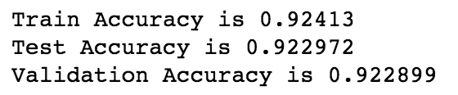
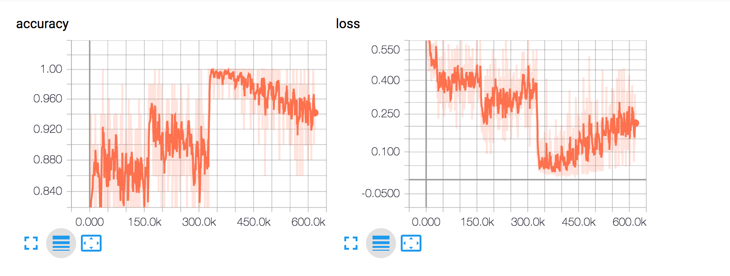
2 Hidden Layers Model – Cont.
After applying the dropout, the performance does not improve significantly.

Slide 21
3 Hidden Layers Model
Out of curiosity, I also applied 3-hidden layer model to see if I can gain further improvements.
Again, it is a fully connected layer with dropout enabled. The construction function can be referred in previous slide. The construction is shown as below.
Two bottom layers have 10 neurons, the upper hidden layer has 5 neurons to consolidate features.
layer1_nn=10
layer2_nn=10
layer3_nn=5
input_x=tf.placeholder(tf.float32,shape=(None,8),name="X")
input_y=tf.placeholder(tf.int32,shape=(None),name="y")
batch_size=50
learning_rate=0.001
hidden1=construct_neural_layer_with_dropout(input_x,layer1_nn,"Hidden_Layer1",keep_prob=0.5,activation_fnc="relu")
hidden2=construct_neural_layer_with_dropout(hidden1,layer2_nn,"Hidden_Layer2",keep_prob=0.5,activation_fnc="relu")
hidden3=construct_neural_layer_with_dropout(hidden2,layer3_nn,"Hidden_Layer3",drop_out=False,activation_fnc="relu")
output=construct_neural_layer_with_dropout(hidden3,2,"Output_Layer",drop_out=False)
loss=tf.reduce_mean(tf.nn.sparse_softmax_cross_entropy_with_logits(labels=input_y,logits=output))
accuracy=tf.reduce_mean(tf.cast(tf.nn.in_top_k(output,input_y,1),tf.float32))
tf.summary.scalar('loss', loss)
tf.summary.scalar('accuracy', accuracy)
merged = tf.summary.merge_all()
train_writer = tf.summary.FileWriter('NN3_dropout')
with tf.name_scope("train"):
optimizer = tf.train.AdamOptimizer(learning_rate)
training_op = optimizer.minimize(loss)
init = tf.global_variables_initializer()

Slide 22
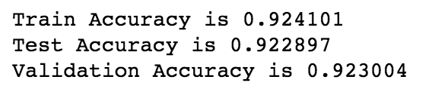
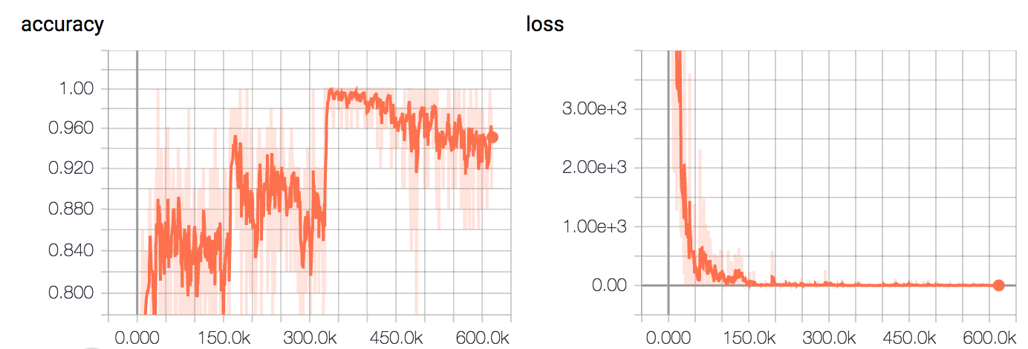
3 Hidden Layers Model – Cont.
However, such structure does not improve the model prediction significantly. The accuracy on test and validation set still stays around 0.923.
It seems that the up trend in the loss is no longer there applying 3-hidden layer with dropout enabled. However, the model accuracy does not improved a lot.

Slide 23
Summary
I applied neural network to construct default model to predict the default in commercial mortgage.
I explore various shape of the neural net (changing number of neurons and the number of hidden layers) to explore the ways to enhance the model. In this experiment, the number of neurons and the training efficiency do not have a monotonic relationship. Also, adding layer does not necessarily boost the model prediction.
By observing the up trend in the loss value for testing set, I applied dropout function to prevent the overfitting of the neural network. The performance improvement is not obvious either.

Slide 24
YouTube URLs, Last Page
Two minute (short): https://youtu.be/lq8o6mh1WNc
15 minutes (long): https://youtu.be/nxN74MNMMzg

